Slide 1



ARTIFICIAL INTELLIGENCE & MACHINE LEARNING PROJECT PARKING SPACE COUNTER
SUBMITTED BY:
JIYA : 2210990463
KARTIK BHARDWAJ : 2210990487
KARTIK GROVER : 2210990488
SUPERVISED BY:
MS. SHAGUN SHARMA

Slide 2
TABLE OF CONTENTS
01 INTRODUCTION
02 PROBLEM STATEMENT & REQUIREMENT
03 TECHNICAL DETAILS
04 KEY FEATURES
05 PROJECT GOALS
06 REFERENCES
07 RESULTS

Slide 3
INTRODUCTION
Background:
Urbanization Challenges: Rapid urbanization has led to an increased concentration of population in cities, exacerbating issues such as traffic congestion, air pollution, and limited parking availability.
Manual Monitoring Limitations: Traditional parking management relies heavily on manual methods, where parking attendants manually monitor parking spaces, which is time-consuming, labour-intensive, and prone to errors.
Need for Automation: With the rise of smart city initiatives and advancements in technology, there is a growing need for automated parking management systems that can optimize parking space utilization, improve traffic flow, and enhance the overall urban experience.
Parking Demand vs Supply Discrepancy: The discrepancy between parking demand and supply is a common challenge in urban areas, where the number of vehicles far exceeds the available parking spaces. This imbalance lead to overcrowded parking’s lots, illegal parking, increased traffic congestion as drivers circle in search of parking.

Slide 4
Significance:
Transformative Impact: The development of a real-time parking spot detection and counting system has the potential to revolutionize parking management practices, offering a more efficient and scalable solution compared to traditional manual methods.
Driver Convenience: By providing real-time information on available parking spaces, the system can significantly reduce the time and frustration associated with searching for parking, improving the overall experience for drivers.
Data-Driven Decision Making: Parking operators and urban planners can leverage the insights provided by the system to make informed decisions regarding parking space allocation, pricing strategies, and infrastructure investments, leading to more effective and equitable parking management.
Urban Mobility and Sustainability: Optimizing parking space utilization can contribute to alleviating traffic congestion, reducing carbon emissions, and promoting sustainable urban mobility patterns, aligning with broader efforts to create livable, environmentally-friendly cities.

Slide 5
PROBLEM STATEMENT
The problem at hand involves the inefficient utilization of parking space in urban areas, leading to congestion, frustration among drivers, and economic losses. Traditional parking management systems are manual, prone to errors, and lack real-time monitoring capabilities, exacerbating the problem. Therefore, there is a need for an automated solution that can accurately detect parking spots, monitor their occupancy status in real-time, and provide actionable insights to optimize parking space utilization.

Slide 6
REQUIREMENTS
Real-Time Detection: The system should be capable of detecting parking spots and monitoring their occupancy status in real-time from a video feed.
Accuracy: The detection algorithm should have high accuracy in identifying parking spots and distinguishing between vacant and occupied spaces, even under varying lighting conditions and environmental factors.
Scalability: The system should be scalable to handle parking lots of varying sizes and configurations, from small lots to large multi-level parking structures.
Robustness: It should be robust against occlusions, shadows, reflections, and other common challenges encountered in parking environments.

Slide 7
User Interface: A user-friendly interface should be provided for parking operators and administrators to monitor parking spot status, view occupancy statistics, and configure system settings.
Alerting Mechanism: The system should have an alerting mechanism to notify parking operators and drivers of any anomalies or emergencies, such as unauthorized parking, vehicle theft, or safety hazards.
Data Privacy: Ensure compliance with data privacy regulations and standards by implementing measures to protect the privacy and security of sensitive information collected by the system.
Maintenance and Support: Provide ongoing maintenance, updates, and technical support to ensure the system's reliability, performance, and longevity.
Cost-Effectiveness: The solution should be cost-effective to implement and maintain, offering a favorable return on investment for parking operators and stakeholders.

Slide 8
TECHNICAL DETAILS
Algorithms Used:
Image Preprocessing: Techniques such as grayscale conversion, Gaussian blurring, adaptive thresholding, and morphological operations have been employed to enhance image quality and reduce noise.
Object Detection: Algorithms have been used for detecting parking spots within the pre-processed images.
Occupancy Monitoring: Once parking spots are detected, algorithms can track vehicle presence over time using techniques such as background subtraction, motion detection, or object tracking.
Data Storage and Retrieval: Structured data storage formats like CSV have been used to store information about parking spot locations, occupancy status, timestamps, and any associated metadata.

Slide 9
Integration with Existing Infrastructure: The system should integrate seamlessly with existing parking infrastructure, such as CCTV cameras or sensor networks.
User Interface: A graphical user interface (GUI) can be designed to visualize parking spot detections, display occupancy statistics, and provide controls for system configuration.
Maintenance and Updates: Automated update mechanisms and remote monitoring tools can be implemented to ensure the system remains operational and up-to-date. Version control systems like Git can be used to manage codebase changes, track issues, and collaborate with team members.
Testing and Validation: Thorough testing and validation procedures should be implemented to verify the functionality, performance, and reliability of the system. This may include unit testing, integration testing, stress testing, and real-world field trials to evaluate the system under diverse conditions.

Slide 10
KEY FEATURES
Real-time Detection System: Develop a robust system capable of detecting parking spots in real-time from a video feed, allowing for immediate response to changes in parking availability.
Computer Vision Techniques: Utilize computer vision techniques, particularly leveraging the capabilities of OpenCV and related libraries, to analyze video frames, identify parking spots,
Enhanced Spot Visibility: Implement preprocessing steps such as image enhancement, noise reduction, and feature extraction to improve the visibility and accuracy of detected parking spots.
Data Management: Design efficient data storage and retrieval mechanisms to maintain the state of parking spots across multiple video frames, ensuring continuity and reliability in the detection process.
Accuracy Improvement: Enhance the accuracy of parking spot detection algorithms by implementing advanced image processing techniques.

Slide 11
PROJECT GOALS
Transformative Impact: The development of a real-time parking spot detection and counting system has the potential to revolutionize parking management practices, offering a more efficient and scalable solution compared to traditional manual methods.
Driver Convenience: By providing real-time information on available parking spaces, the system can significantly reduce the time and frustration associated with searching for parking, improving the overall experience for drivers.
Data-Driven Decision Making: Parking operators and urban planners can leverage the insights provided by the system to make informed decisions regarding parking space allocation, pricing strategies, and infrastructure investments, leading to more effective and equitable parking management.

Slide 12
REFERENCES
VIDEO REFERENCES: https://www.youtube.com/watch?v=caKnQlCMIYI
CODE REFERENCE: https://www.computervision.zone/lessons/files-and-code-2/
ABOUT:
OPENCV: https://www.geeksforgeeks.org/opencv-overview/
PICKLE: https://www.geeksforgeeks.org/understanding-python-pickling-example/
NUMPY: https://www.w3schools.com/python/numpy/numpy_intro.asp

Slide 13
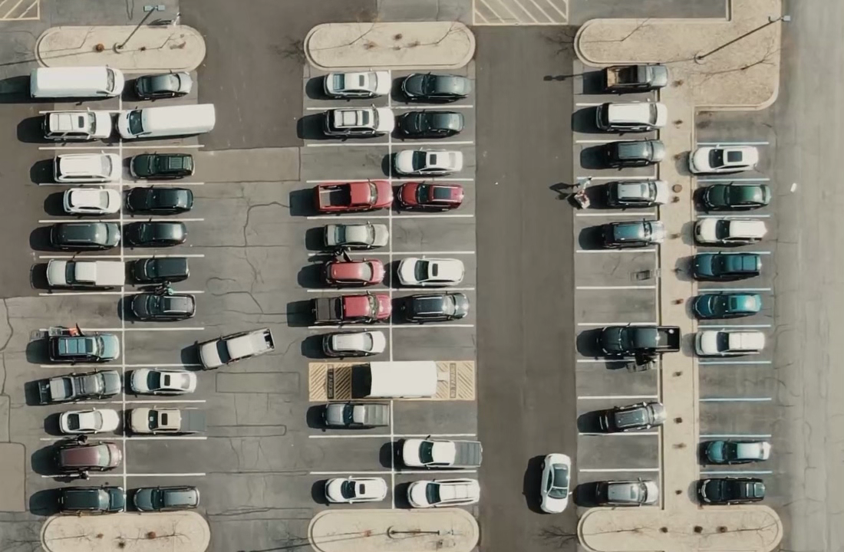
RESULTS
01 CAR PARKING IMAGE

Slide 14
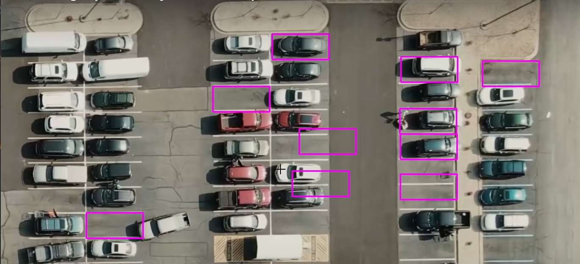
02 MAKING RECTANGLE ON IMAGE USING FUNCTION ‘MOUSECLICK’

Slide 15
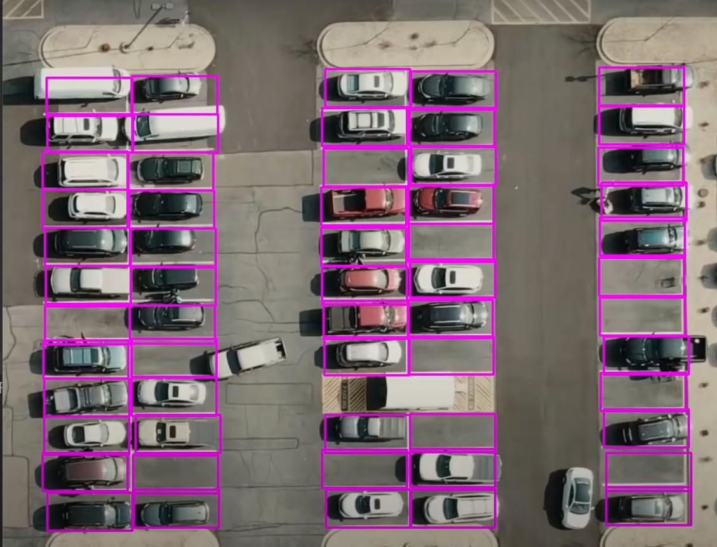
03 LOADING PARKING SPACE POSITIONS

Slide 16
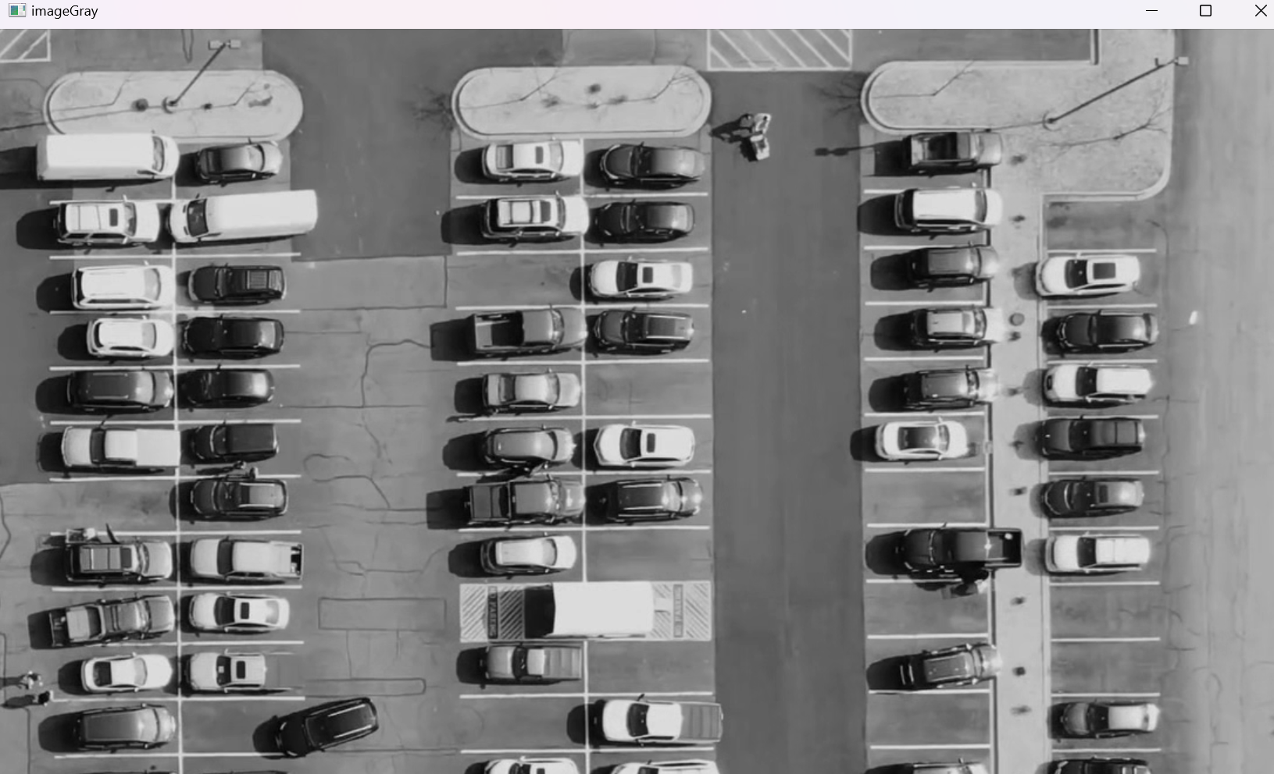
04 CONVERTING IMAGE TO GRAYSCALE

Slide 17
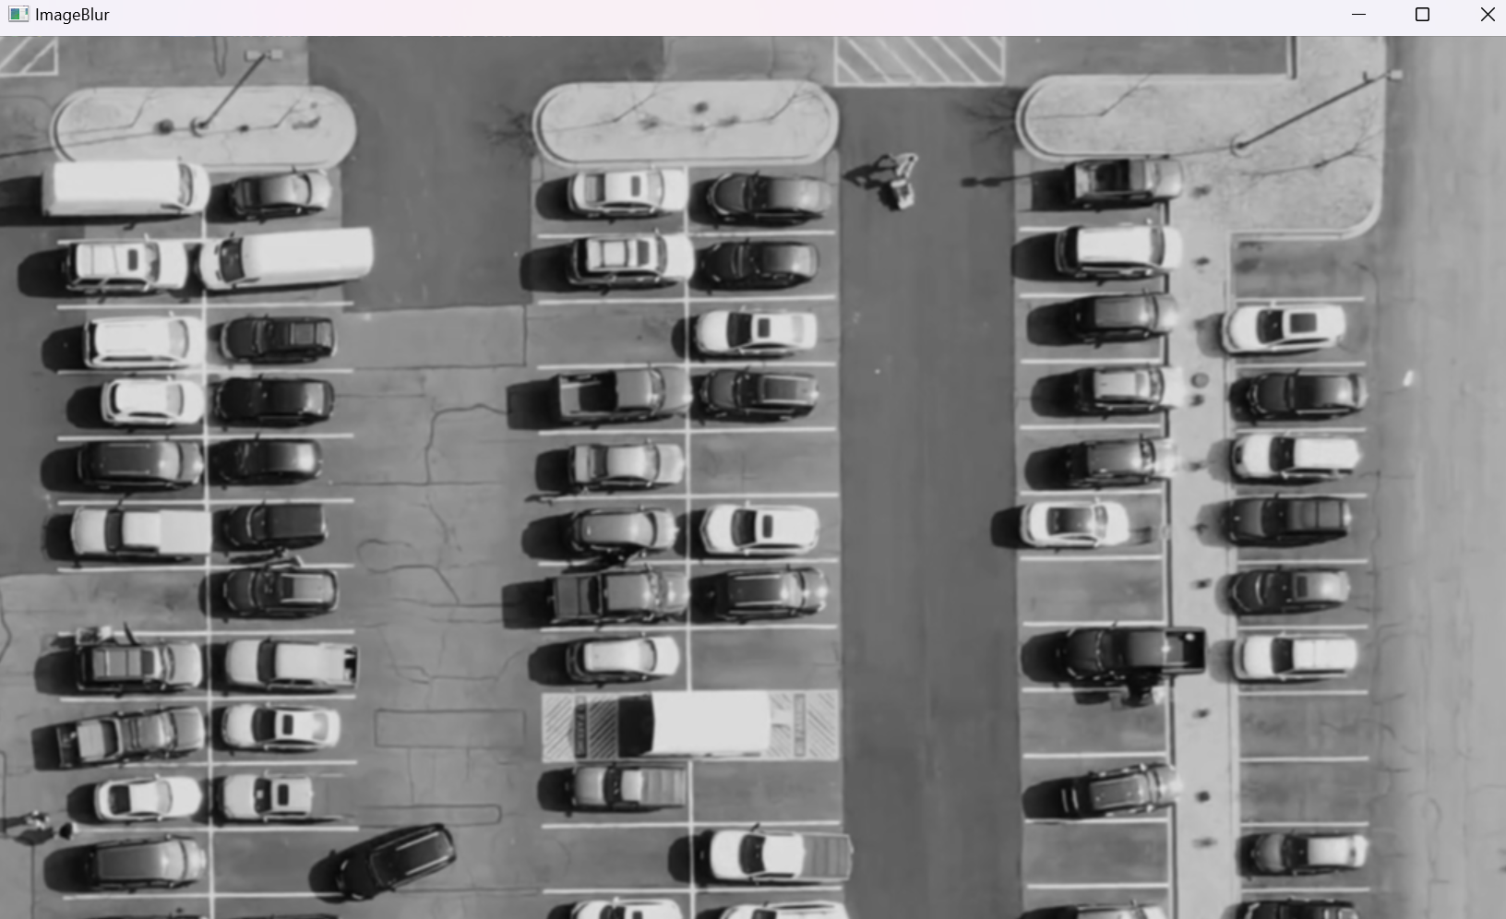
05 APPLYING GAUSSIAN BLUR

Slide 18
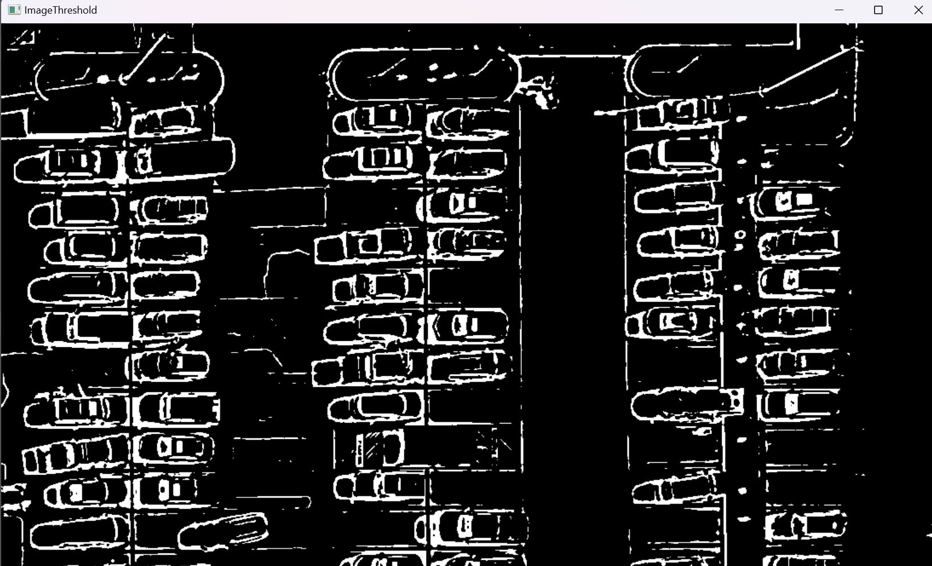
06 APPLYING ADAPTIVE THRESHOLD

Slide 19
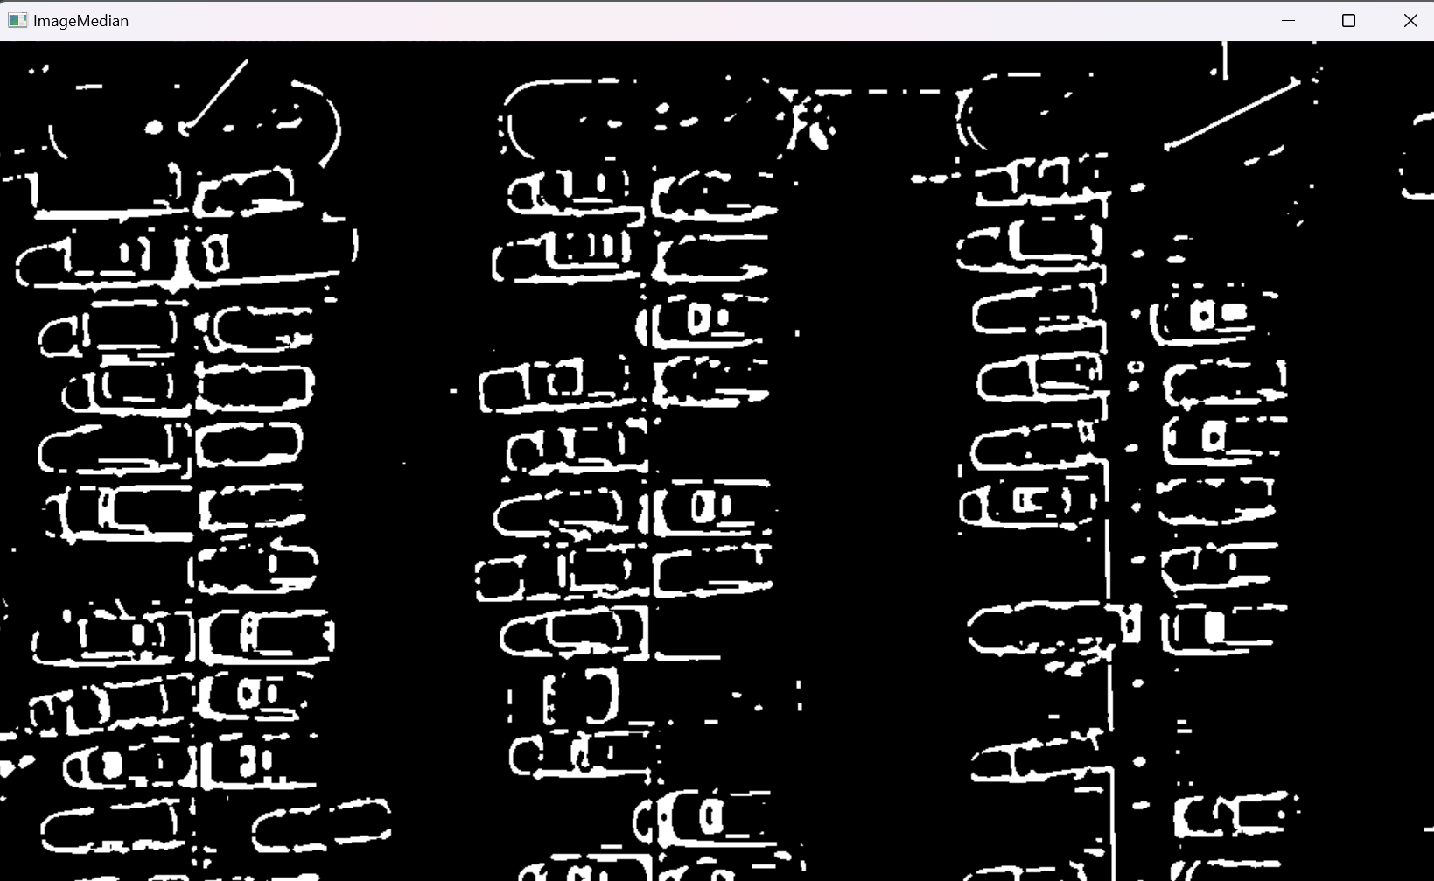
07 APPLYING MEDIAN BLUR

Slide 20
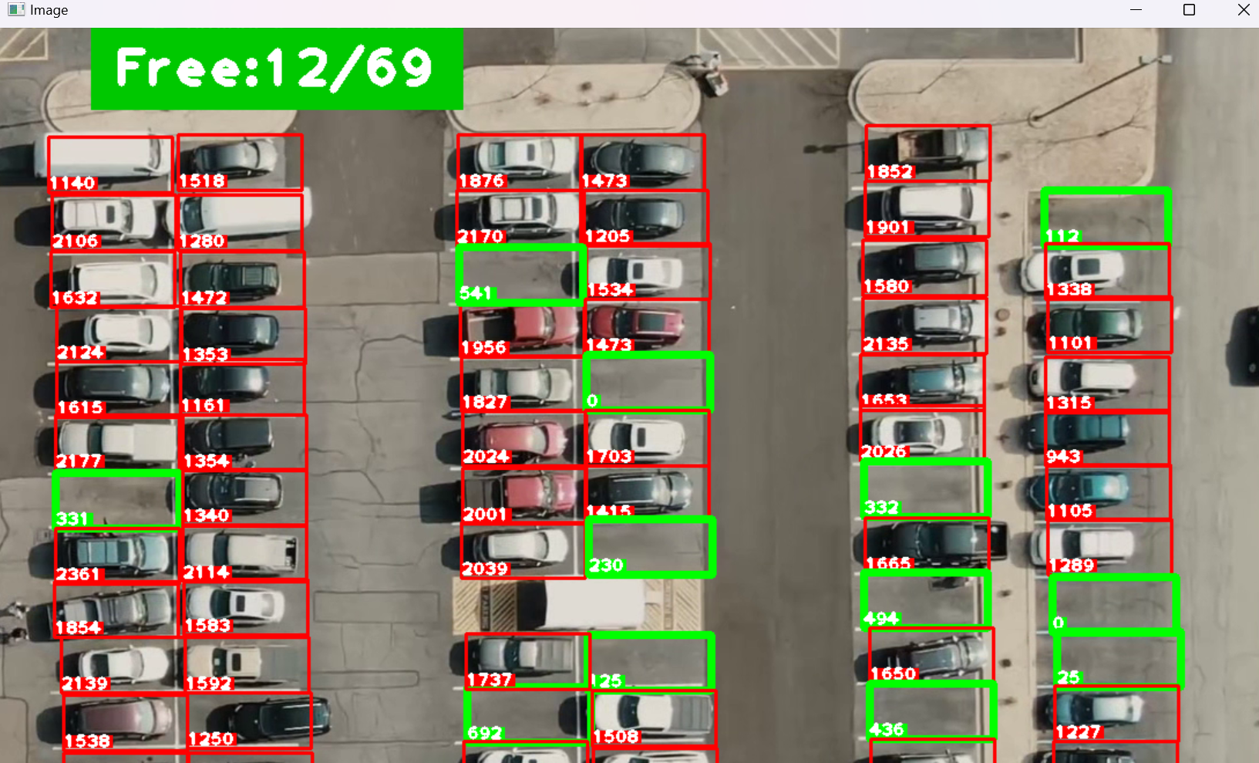
08 FINAL OUTPUT

Slide 21
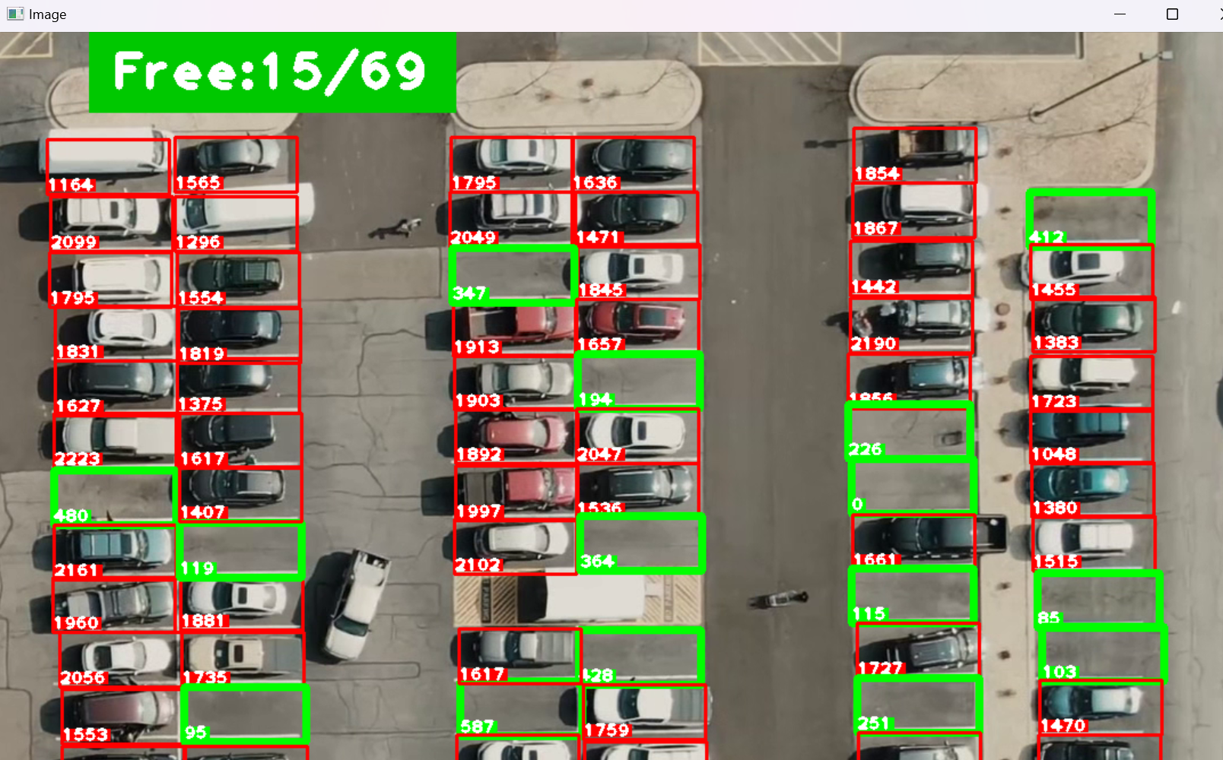

Slide 22
THANK YOU

